Slide 1
Welcome to Poland
School in Siedlec, Poland – Primary and Secondary School

Slide 2
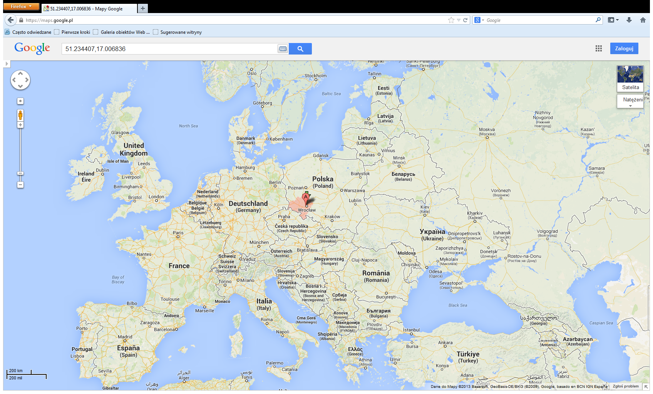
Our place on the map of Europe

Slide 3
Siedlec on the map of Poland

Slide 4
Symbols of school in Siedlec
Old building
New school
patron
flag
logo

Slide 5
The corner of our Patron Priest Jan Twardowski

Slide 6
Wrocław – the capital of Lower Silesia
Centennial Hall
Wrocław Main Railway Station
Multimedial Fountain

Slide 7
Every single day at school

Slide 8
School picnic

Slide 9
School events

Slide 10
Competitions

Slide 11
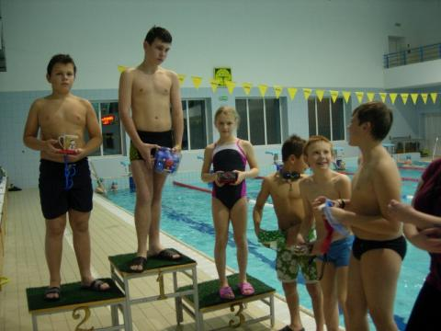
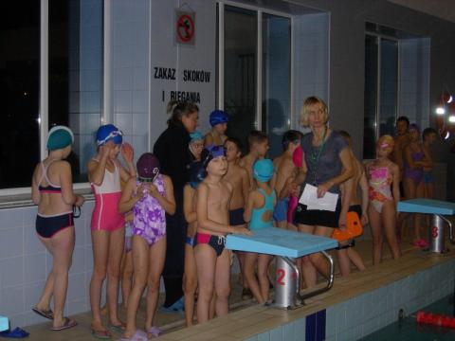
Sport competitions

Slide 12
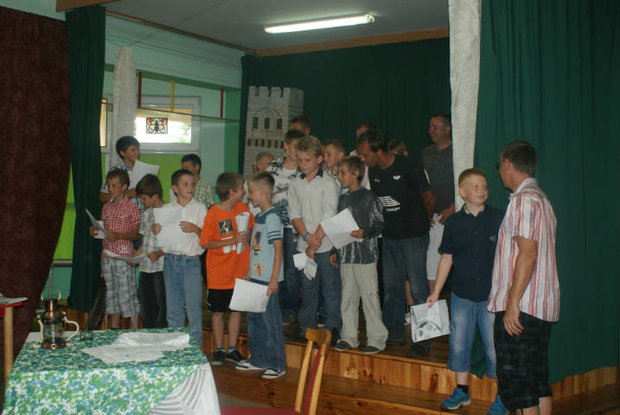
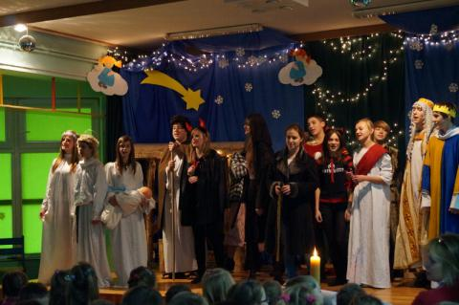
Performances

Slide 13
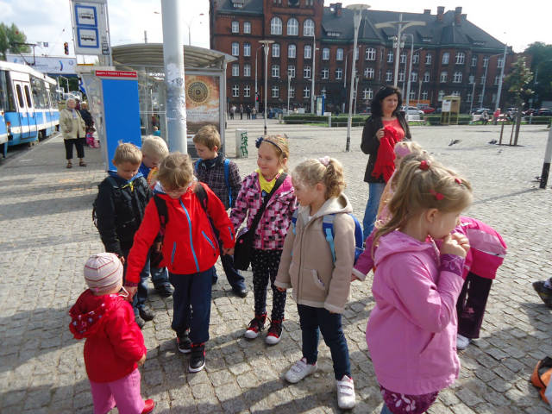
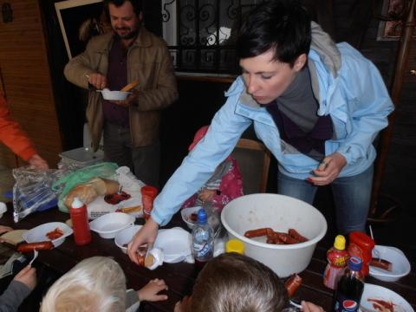
Trips

Slide 14
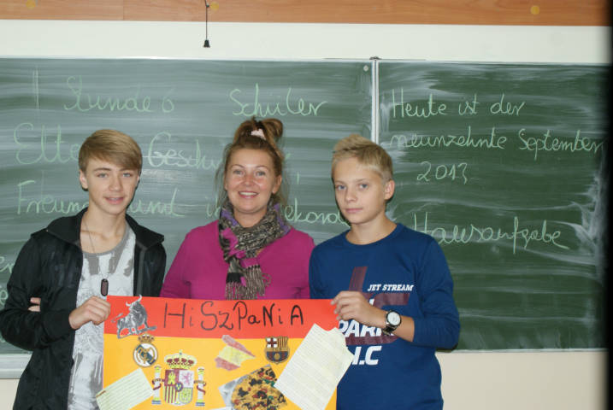
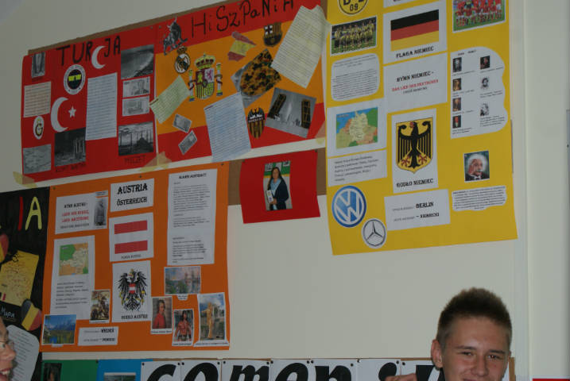
Comenius wall

Slide 15
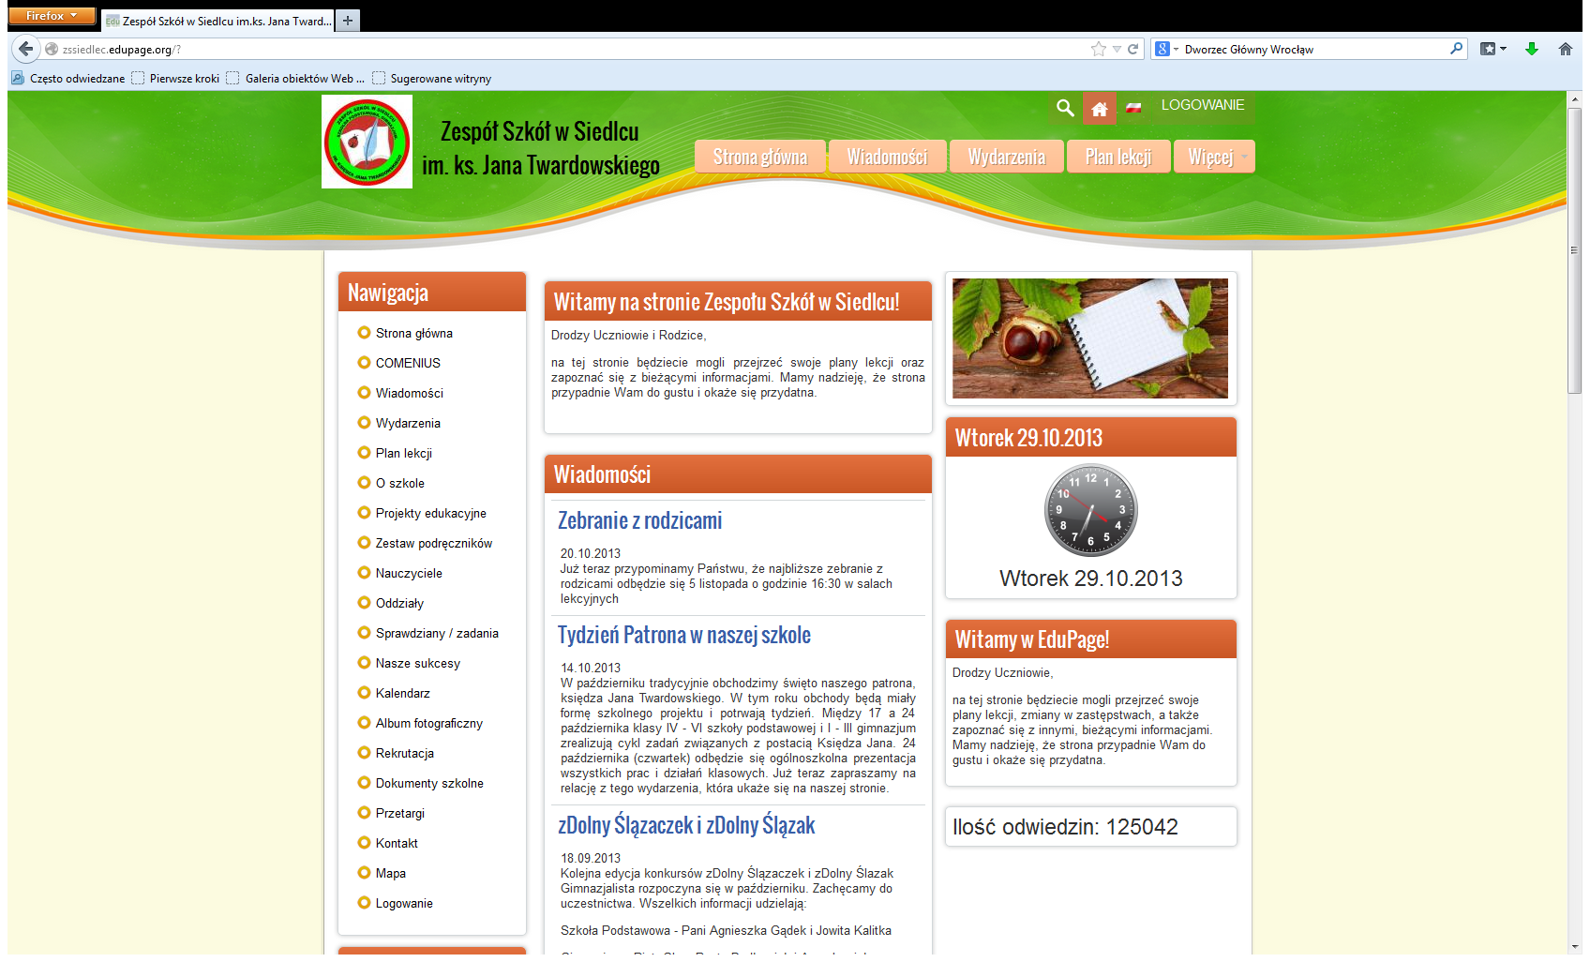
Website of our school

Slide 16
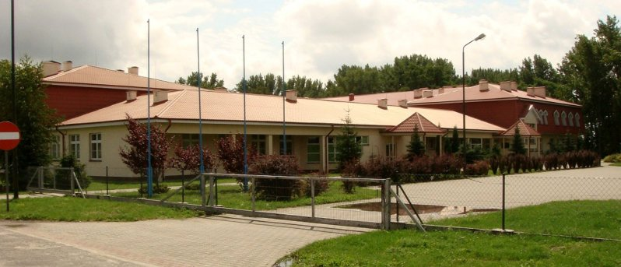
We invite you to our school in Poland

