Slide 1
best of the best

Slide 2
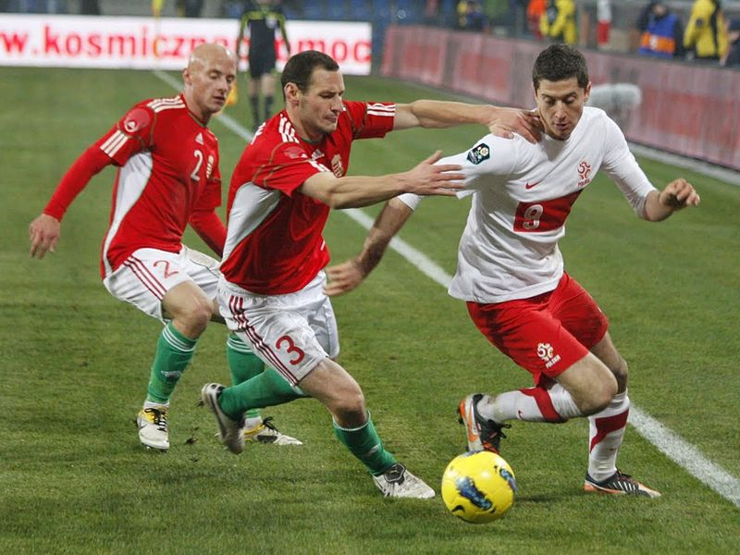
Best of the best : Sport
Robert Lewandowski - is the best and the most popular Polish footballer who plays in the Polish national team and as striker for the German Bundesliga club Borussia Dortmund.
We are very happy, that we have such a great sportsman
Lewandowski (right) playing for Poland against Hungary

Slide 3
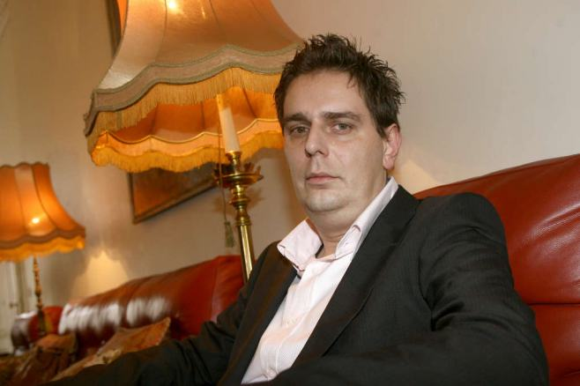
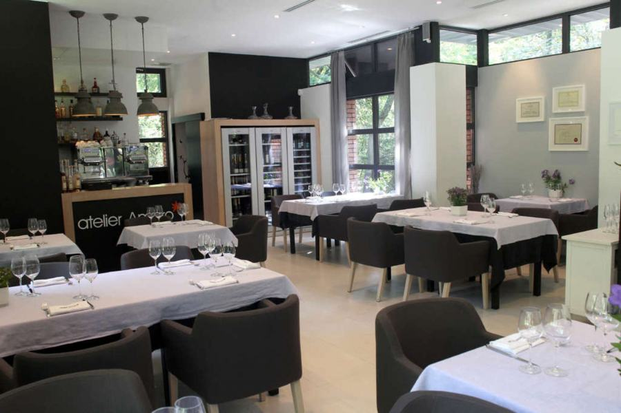
Best of the best : Food
Wojciech Modest Amaro is the best Polish chef and restaurant owner. His restaurant, Atelier Amaro, which is located at ul. Agricola 1 in Warsaw, got a Michelin star. Michelin Guide, admits Michelin stars for excellence to a select few establishments.
Wojciech Modest Amaro His Restaurant

Slide 4
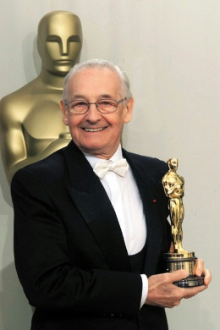
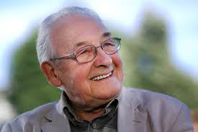
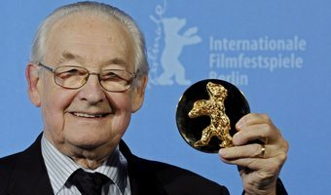
Best of the best : Cinema
Andrzej Wajda is the best Polish film director. We owe him the best Polish films, i.a „Wałęsa. Człowiek z nadziei”, „Zemsta”, „Katyń”, „Pan Tadeusz”. Director for his contribution to the development of cinema was the award-winning, among others,
received a Lifetime Achievement Award
in 2000 Academy Award - Oscar

Slide 5
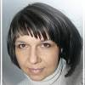
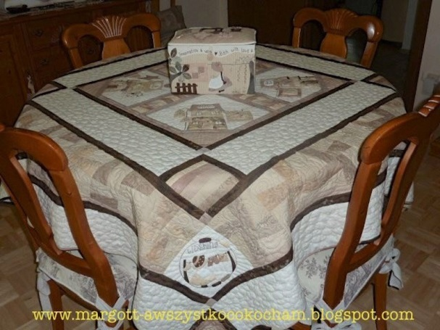
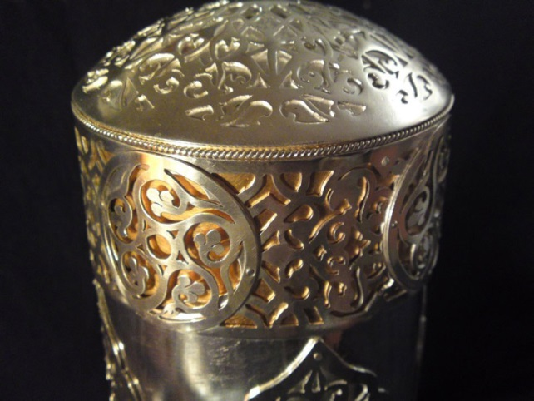
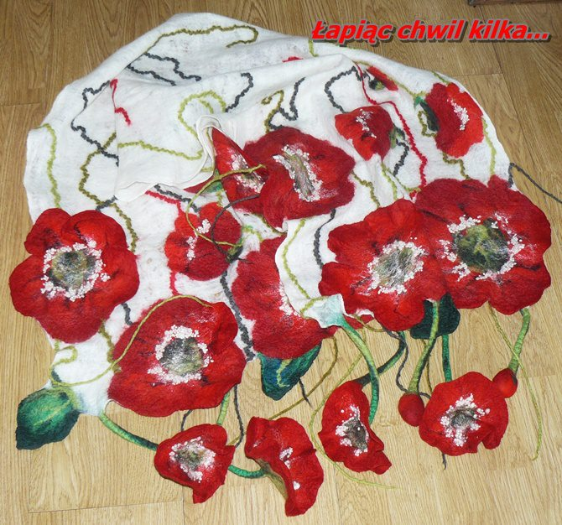
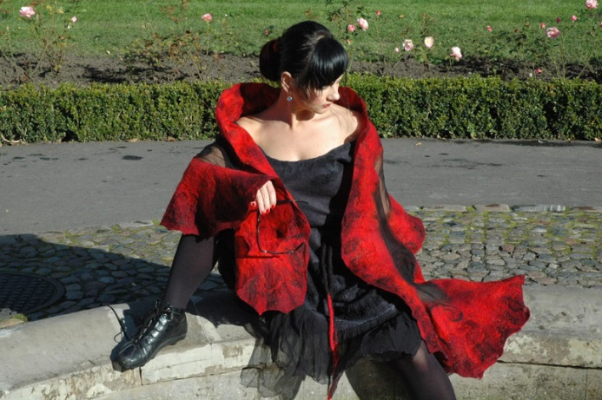
Best of the best : Handicraft
Bożena Pelczar is the best performer of handicrafts.
She has done a lot of beautiful clothes, jewelery and ornaments, as well as everyday items.

Slide 6
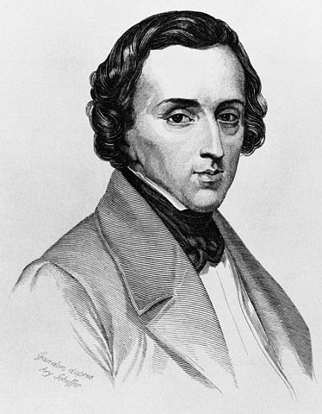
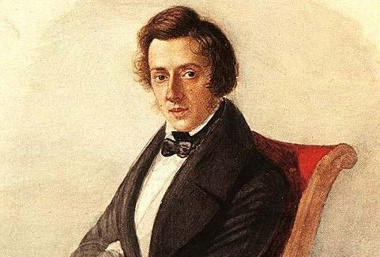
Best of the best : Music
Fryderyk Chopin was a Polish composer and pianist. From 1838 he lived in France. Chopin is considered one of the most important composers of the romantic, as well as one of the most important Polish composers in history.

Slide 7
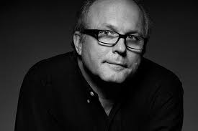
Best of the best : Photography
Tomasz Tomaszewski is Polish photographer, creator of press photographs. Associate National Geographic magazine (the pictures included in the set of the best photographs NG); lecturer of photography in Poland, USA, Germany and Italy. He has recorded numerous solo exhibitions in the country and abroad, Polish and Fiction books.

Slide 8
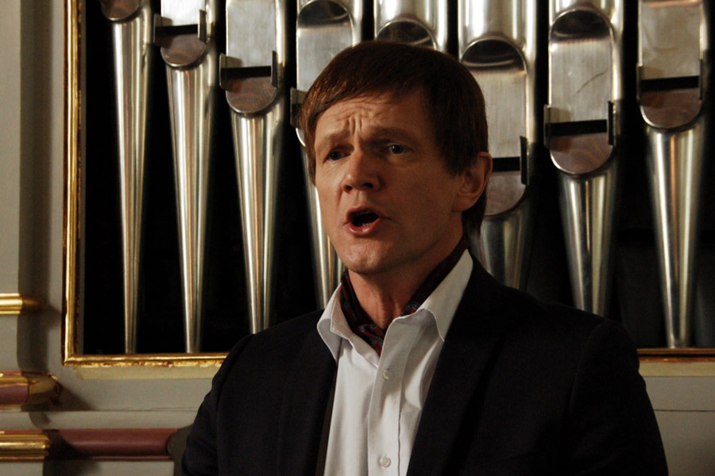
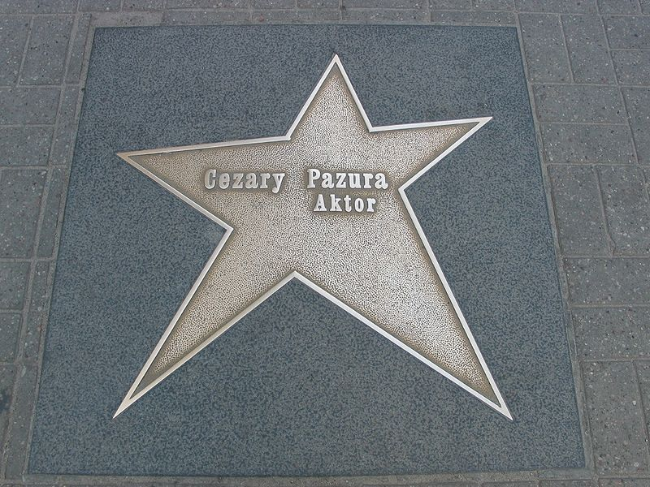
Best of the best : Theatre
Cezary Pazura is Polish film actor, cabaret and television comedian, singer and director. He graduated in 1986, the National Film School in Lodz. Initially, he was associated with the theater, just after graduating from high school he joined the Ochota Theatre in Warsaw, then in 1992-93 he worked in the Common Theatre

Slide 9
Thank you for your attention ☺

